Slide 1

Vel Tech Rangarajan Dr. Sagunthala R&D Institute of Science and Technology
School of Computing
Department of Computer Science and Engineering
10211CS224 / FULL STACK APPLICATION DEVELOPMENT (JAVA)
PROJECT REVIEW: MILESTONE PROJECT – 1
Date: 26-03-2026
Responsive E-Commerce Interface with State-Persistent Cart
SDG 8 – Decent Work and Economic Growth
Presented By:
B JERUSHA – VTU24393 – 23UECS0232
Courses Handling Faculty:
Dr. Hafizur Rahman

Slide 2
INTRODUCTION
The Responsive E-Commerce Web Application with Session-Based Cart Management is a full-stack web platform designed to deliver a seamless and dynamic online shopping experience. Built using Java (Spring Boot) on the backend and a responsive frontend, the application allows users to browse products, manage their shopping cart, and complete purchases efficiently across all devices and screen sizes.
Unlike traditional static e-commerce pages, this system uses HTTP session management to persistently track cart data per user without requiring login, enabling a frictionless shopping flow. The application bridges the gap between basic product listing websites and fully-featured shopping platforms by incorporating real-time cart updates, product categorization, and a clean responsive UI.
This project is relevant in today’s digital commerce landscape where mobile-first, real-time, and user-friendly interfaces are essential for business success. It demonstrates core full-stack development skills including REST APIs, session handling, database integration, and adaptive design patterns applicable to real-world industry scenarios.
1
2
3
4
5
6
7
8
9

Slide 3
Most existing e-commerce platforms require users to create accounts or log in before they can browse and add products to a cart, creating unnecessary friction in the shopping experience. For small and medium-scale online businesses, setting up a fully authenticated user system adds significant development complexity and cost.
There is a lack of lightweight, session-driven shopping cart solutions that work effectively without mandatory user registration. Additionally, many existing platforms are not fully responsive, resulting in poor usability on mobile and tablet devices, which now account for the majority of online shopping traffic.
This project addresses the need for a streamlined, full-stack e-commerce web application that manages cart data through server-side HTTP sessions, enables browsing and purchasing without mandatory login, and delivers a consistent, responsive experience across all device types and screen sizes.
1
2
3
4
5
6
7
8
9

Slide 4
1
To design and develop a responsive, full-stack e-commerce web application using Java Spring Boot as the backend framework and a mobile-first frontend, enabling users to browse product listings, view product details, and complete purchases seamlessly across desktops, tablets, and smartphones.
To implement a robust session-based cart management system that persists shopping cart data per user session without requiring account registration, ensuring a frictionless and secure shopping experience while maintaining data integrity throughout the user journey.
2
3
4
5
6
7
8
9

Slide 5
The proposed system is a Java-based full-stack e-commerce web application that supports end-to-end online shopping functionality. Users can browse product categories, view detailed product pages, add or remove items from their cart, and proceed through a streamlined checkout process, all without needing to create an account.
The core innovation of this system lies in its session-based cart management, where the server maintains each user’s cart state through HTTP sessions. This approach eliminates the need for a user authentication system at the cart level, reducing complexity while ensuring that cart contents are preserved for the duration of the browsing session.
The system features a fully responsive UI that adapts to any screen size, a RESTful API backend, a relational database for product and order data, and clean MVC architecture. Compared to existing systems that enforce login for cart access, this solution offers faster onboarding, lower development overhead, and a superior user experience for guest shoppers.
1
2
3
4
5
6
7
8
9

Slide 6
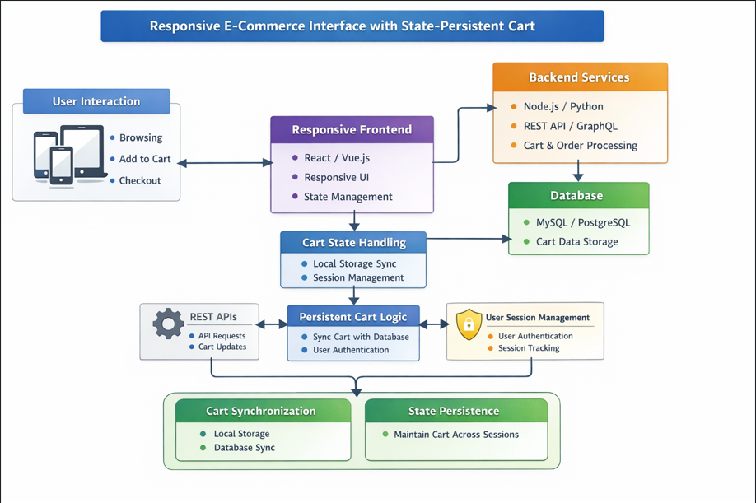
The system follows a layered MVC (Model-View-Controller) architecture. The frontend (View layer) is built with HTML5, CSS3, and JavaScript using responsive design principles, communicating with the backend through RESTful HTTP requests. The Controller layer, implemented in Spring Boot, handles incoming requests, processes business logic, and manages session objects for cart state.
Input: Users interact with the frontend by searching products, selecting items, adjusting quantities, and initiating checkout. Product data is fetched dynamically from the backend. Processing: The Spring Boot application processes cart operations (add, update, remove) and maintains cart state in the HTTP session. Checkout requests trigger order creation and inventory updates.
Database: A relational database (MySQL) stores product catalogs, category mappings, order records, and customer information. Spring Data JPA is used for ORM-based data access. Output: The system renders updated cart views, order confirmation pages, and product listings dynamically, delivering real-time feedback to the user through the responsive frontend interface.
1
2
3
4
5
6
7
8
9

Slide 7
1
The user begins by accessing the homepage, where featured products and categories are displayed dynamically. The user can search or filter products by category, price range, or keyword. Upon selecting a product, a detailed view is presented with description, price, and available stock information.
When the user adds a product to the cart, the application sends a POST request to the Spring Boot backend. The controller retrieves the current session, accesses the session-stored cart object, adds the selected item, and persists the updated cart back into the session. No database write is required for cart operations until checkout is initiated.
At checkout, the cart data is read from the session, an order record is created in the database, inventory quantities are updated, and a confirmation response is returned to the user. The session cart is then cleared. At any point, the user can view, update quantities, or remove items from the cart, with all changes reflected immediately in the session and on the UI.
2
3
4
5
6
7
8
9

Slide 8
1
Frontend: HTML5, CSS3, JavaScript, Bootstrap 5 for responsive layout and UI components, Thymeleaf as the server-side template engine for dynamic page rendering, and Fetch API / AJAX for asynchronous product and cart operations without full page reloads.
Backend: Java 17 with Spring Boot 3.x as the primary backend framework, Spring MVC for RESTful API and request handling, Spring Data JPA for database interaction and ORM, and Spring Session for HTTP session-based cart management and state persistence.
Database: MySQL 8.0 as the relational database management system for storing product catalog, categories, orders, and customer data. Hibernate as the JPA provider for entity mapping and query execution. Tools: Apache Maven for build and dependency management, IntelliJ IDEA as the development IDE, Git and GitHub for version control, and Postman for API testing.
Hardware/Software Requirements: JDK 17+, Apache Tomcat (embedded), MySQL Server, modern web browser, minimum 8GB RAM development machine.
2
3
4
5
6
7
8
9

Slide 9
Module 1: Product Catalog Management - This module handles the display, search, and filtering of all products. Products are organized by category and can be searched by name or filtered by price. Product data including name, description, price, image, and stock quantity is fetched from the MySQL database via Spring Data JPA and rendered dynamically on the frontend using Thymeleaf templates.
Module 2: Session-Based Cart Management - This is the core module of the application. When a user adds a product to the cart, the system creates or retrieves a Cart object stored in the HTTP session. All cart operations such as adding, removing, and updating item quantities are performed on this session object, ensuring data persistence across page navigations without database overhead or mandatory login.
Module 3: Checkout and Order Processing - This module manages the checkout flow. On checkout, the cart data from the session is validated, an Order entity is created and persisted to the database, and product stock quantities are updated accordingly. The user receives an order confirmation with a summary of purchased items, total cost, and estimated delivery information.
Module 4: Responsive UI and Navigation - This module handles the frontend presentation layer. Using Bootstrap 5 and custom CSS, all pages adapt fluidly across screen sizes. The navigation includes a persistent cart icon with item count, a dynamic search bar, and category filters, all updated in real time using AJAX without requiring full page reloads.
1
2
3
4
5
6
7
8
9

Slide 10
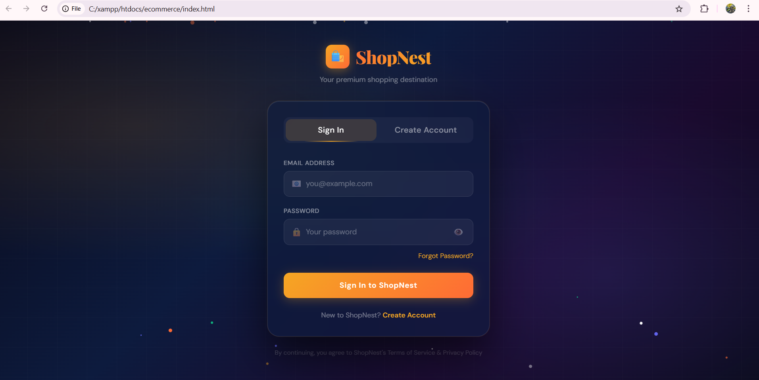
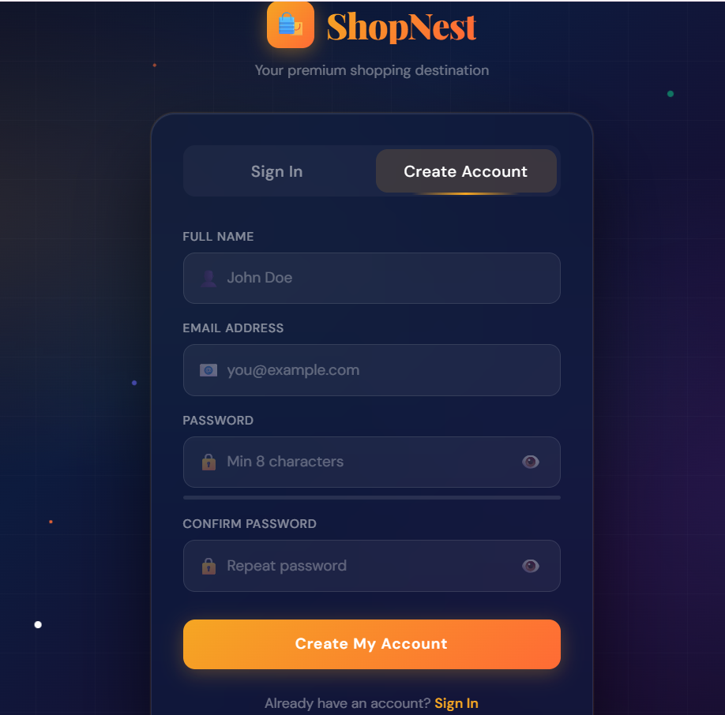
IMPLEMENTATION SCREENSHOTS
1
2
3
4
5
6
7
8
9
The login page authenticates users by verifying their username and password from the user table in the MySQL database. Upon successful login, a session is created and the user is redirected to the main shopping page.
The Create Account page allows new users to register by entering their username, email, and password. The entered details are stored in the user table of the MySQL database for future login authentication.

Slide 11
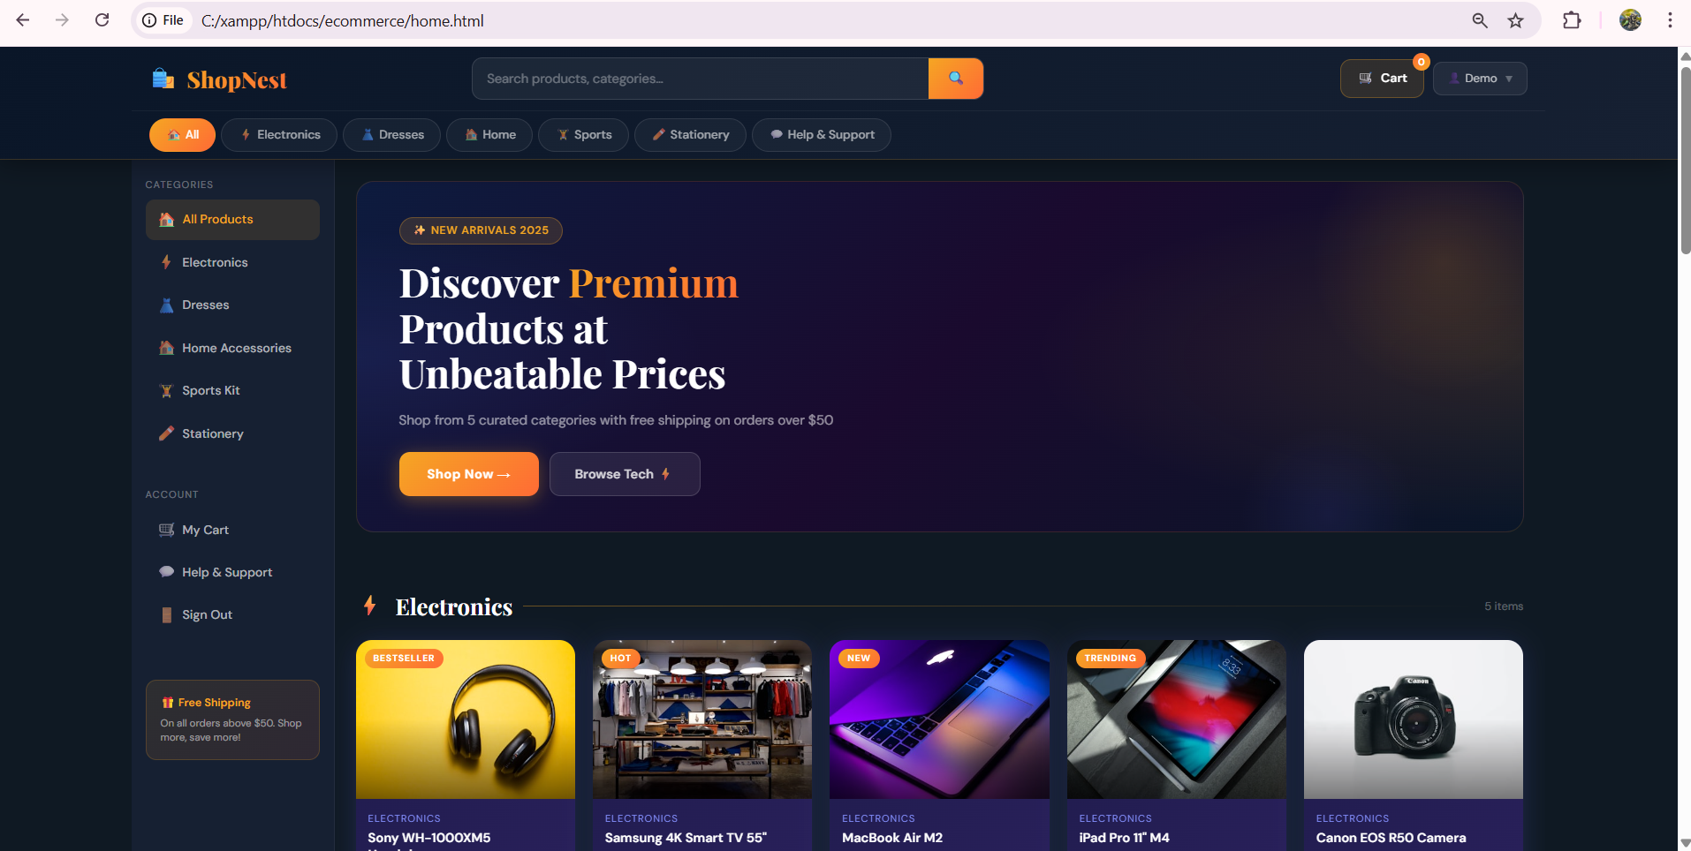
IMPLEMENTATION SCREENSHOTS
1
2
3
4
5
6
7
8(A)
9
The Home Page displays categorized products like Edible Items, Electronic Products, and Dress Items in a responsive layout. Users can browse products, add items to the cart, and navigate through different sections easily.

Slide 12
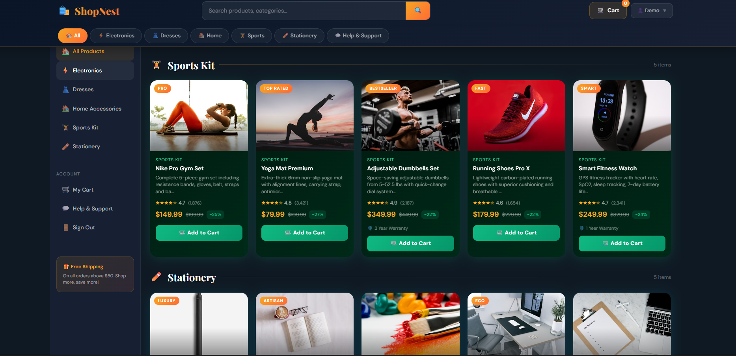
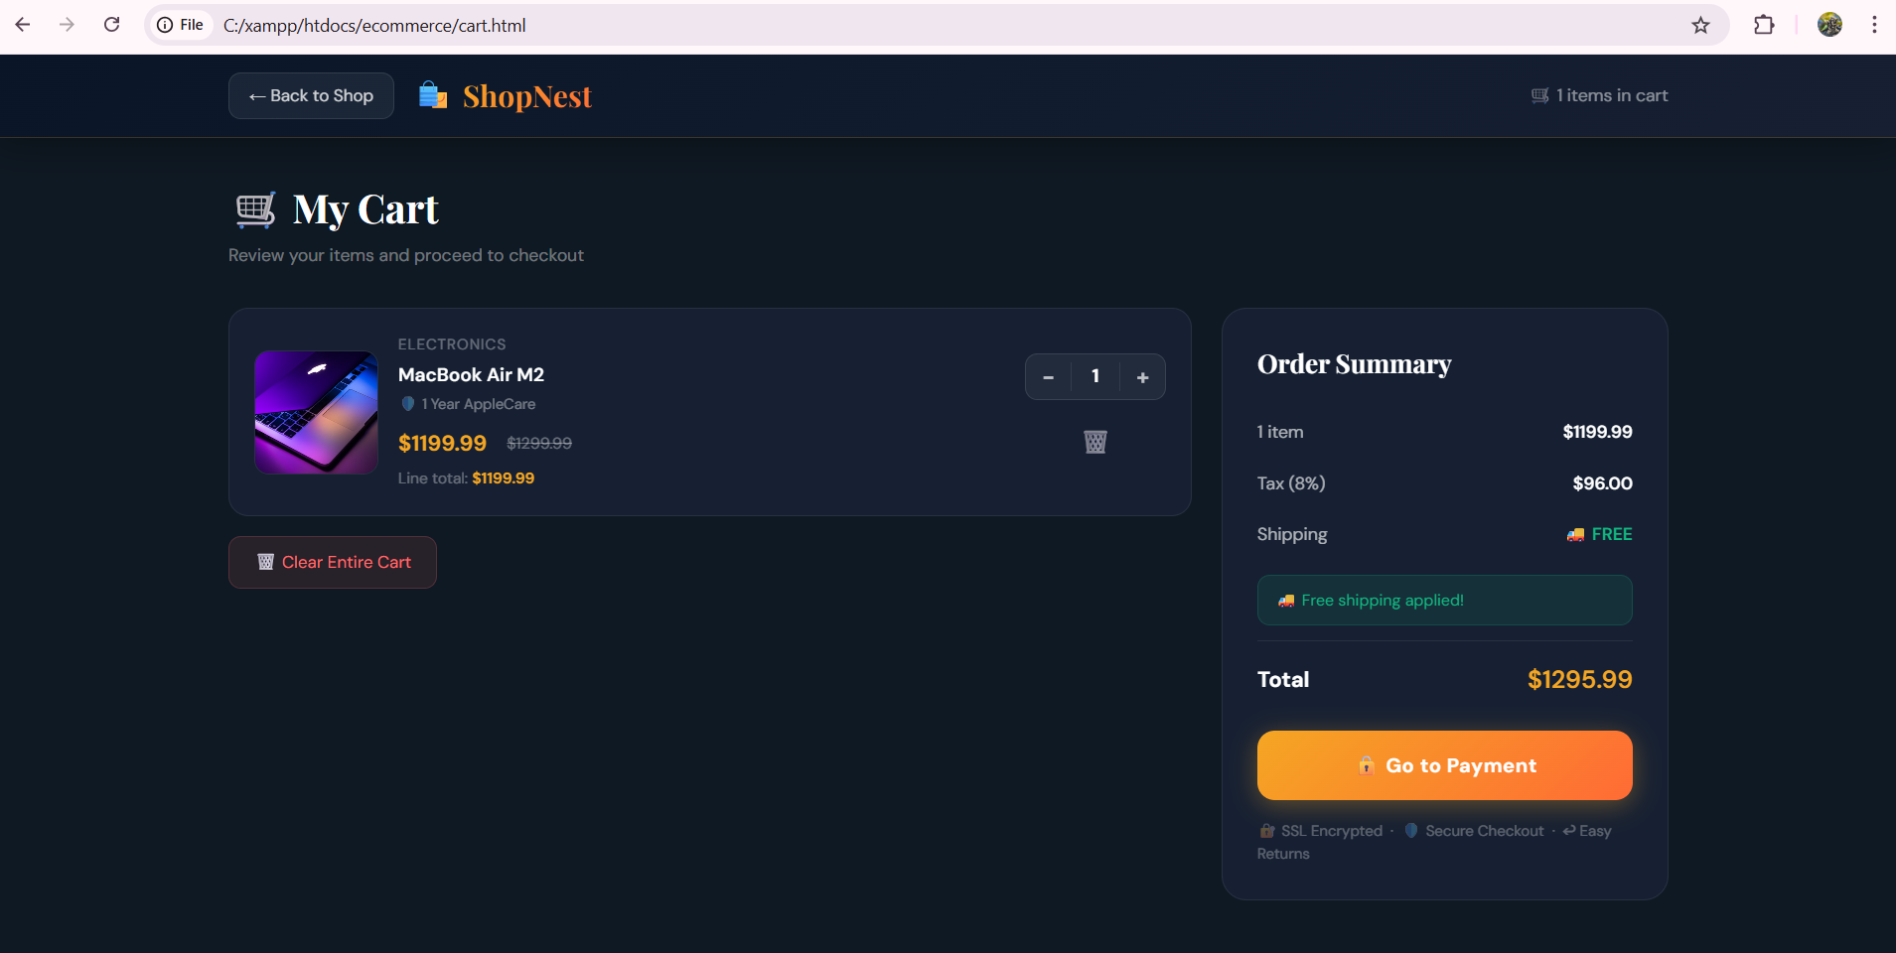
IMPLEMENTATION SCREENSHOTS
1
2
3
4
5
6
7
8(B)
9
The products added include various items with their respective prices. These products are dynamically fetched from the database and displayed in a responsive card layout on the homepage.
The Cart page displays all the products added by the user during the session along with their prices. It calculates and shows the total amount dynamically, allowing users to review their selected items.

Slide 13
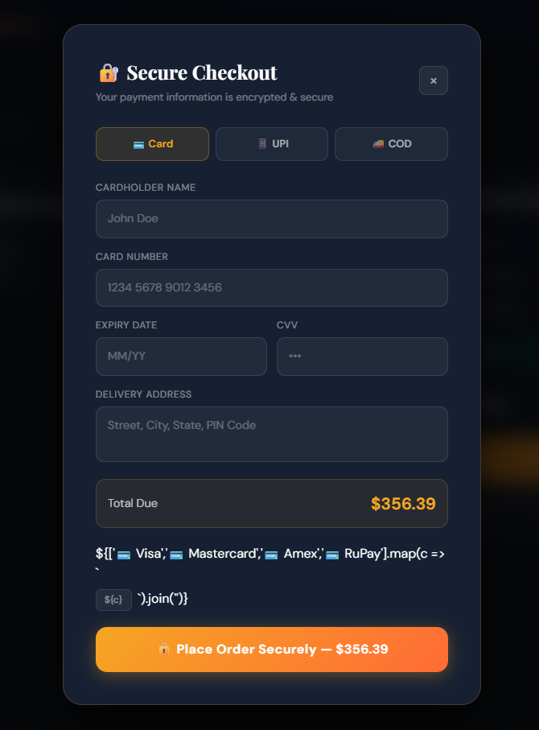
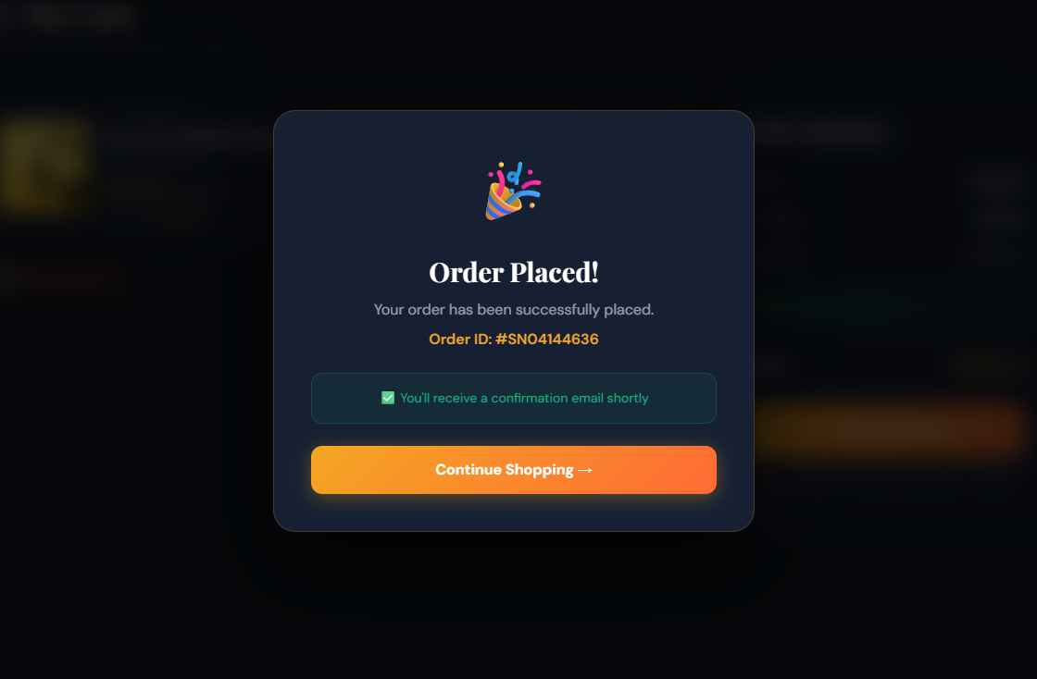
IMPLEMENTATION SCREENSHOTS
1
2
3
4
5
6
7
8(C)
9
The Order Confirmation page displays a success message after the user completes the purchase process. It confirms that the selected items have been successfully processed and clears the cart session data.

Slide 14
Advantages: The session-based cart approach eliminates the need for mandatory user registration before shopping, reducing user drop-off and improving conversion rates. The system is lightweight and scalable, as cart data is stored in-memory at the session level rather than in the database during browsing. The fully responsive design ensures consistent usability across desktops, tablets, and mobile devices, which is critical for modern e-commerce. The use of Spring Boot with Spring Data JPA ensures rapid development, clean code architecture, and easy integration with relational databases. The RESTful API structure allows the backend to be decoupled and reused with future frontend frameworks.
Limitations: Session-based cart data is lost if the user clears browser cookies, switches devices, or if the server session expires due to timeout, which can impact user experience for long shopping sessions. The current implementation does not support persistent cart data for returning users, as cart information is not stored in the database between sessions. The absence of a full user authentication module limits personalization features such as order history, wish lists, and saved addresses. Additionally, high concurrent user loads may increase server-side memory usage due to session storage, requiring careful session timeout configuration and infrastructure planning for production deployment.
1
2
3
4
5
6
7
8
9

Slide 15
Thank you

